Slide 1
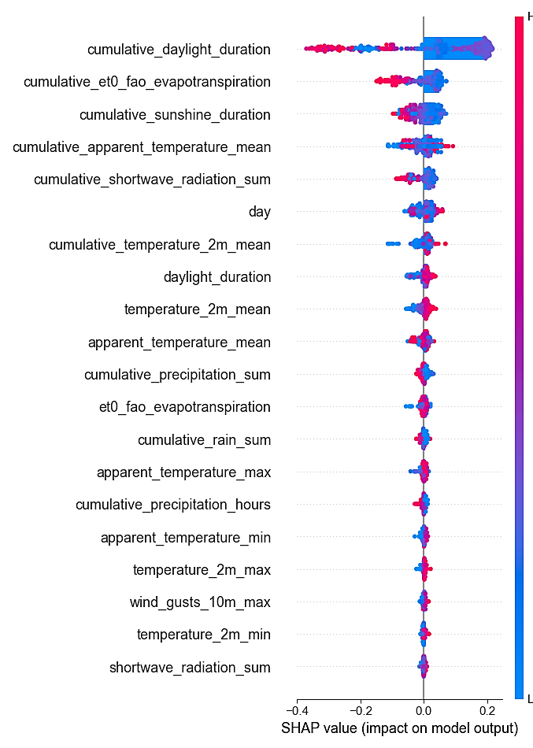
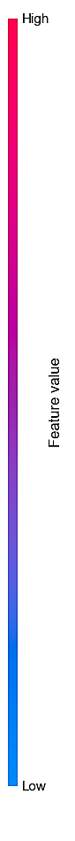
Mean SHAP Value
Variable name
0.0633
0.0498
0.0476
0.0329
0.0301
0.0260
0.0244
0.0134
0.0121
0.0105
0.0094
0.0077
0.0076
0.0073
0.0068
0.0064
0.0050
0.0047
0.0040
0.0038

